Slide 1


Cities in shape:
Assessing the impact of urban form on accessibility
Clara Peiret-García
Prof. Rachel Franklin
Dr. Alistair Ford
Dr. Joe Matthews

Slide 2
Introduction
Research question
Methods
Results
Conclusions

Slide 3
Accessibility & urban form

Slide 4
Accessibility
Accessibility is the ease with which opportunities can be reached from an origin [1]
[1] Páez, A., Scott, D.M. and Morency, C., 2012. Measuring accessibility: positive and normative implementations of various accessibility indicators. Journal of Transport Geography, 25, pp.141-153.

Slide 5
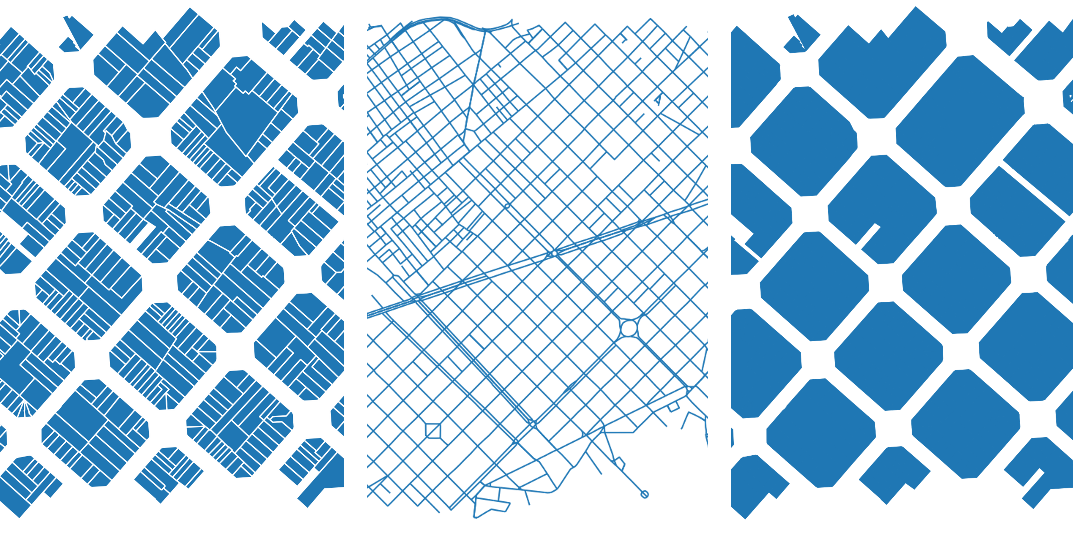
Urban form

Slide 6
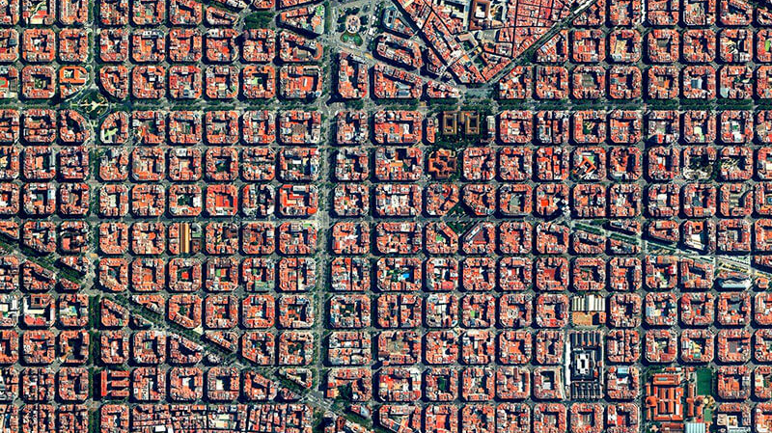
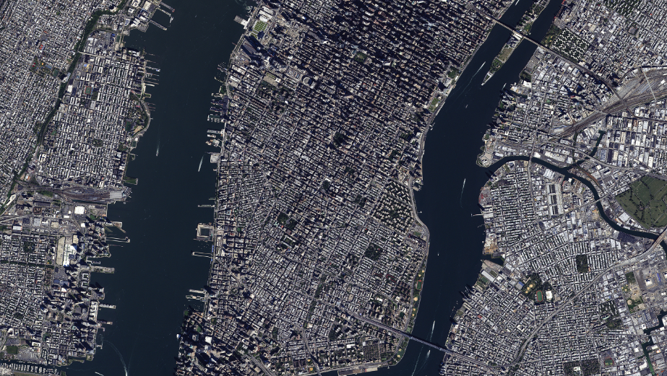
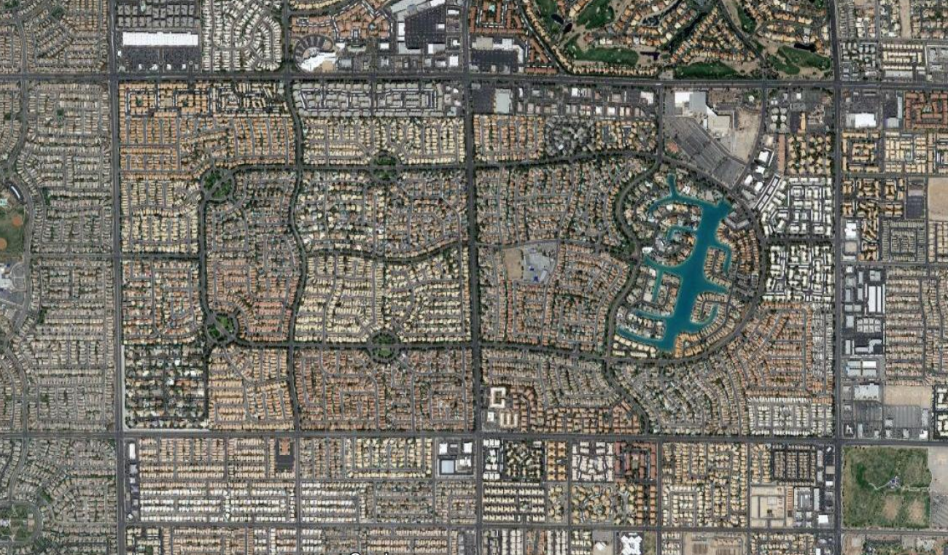
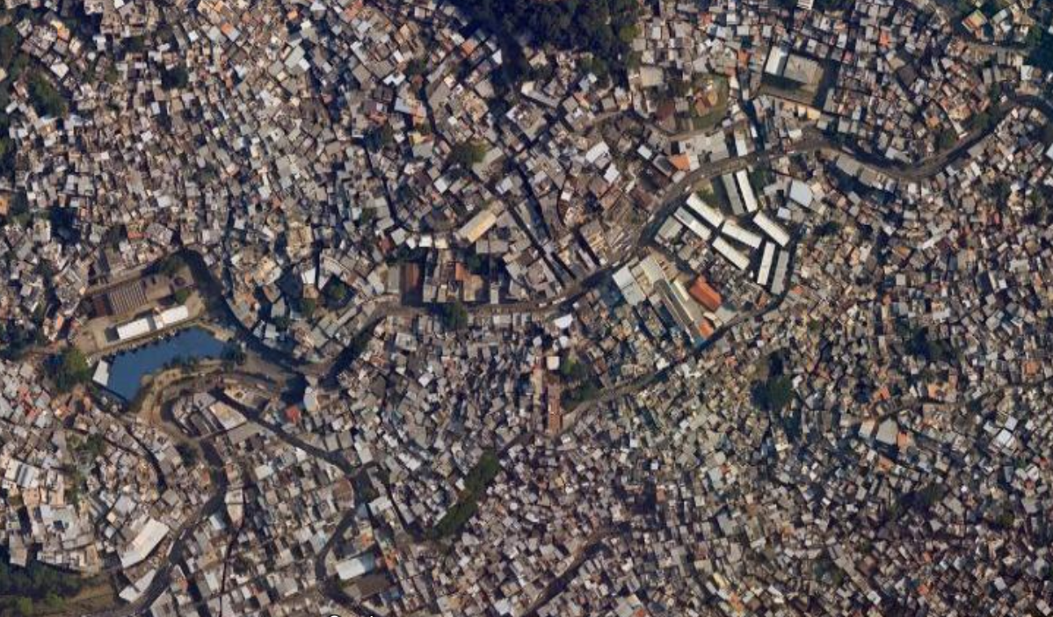

Slide 7
Research question

Slide 8
Research question
What does an accessible city look like to different people?

Slide 9


Slide 10
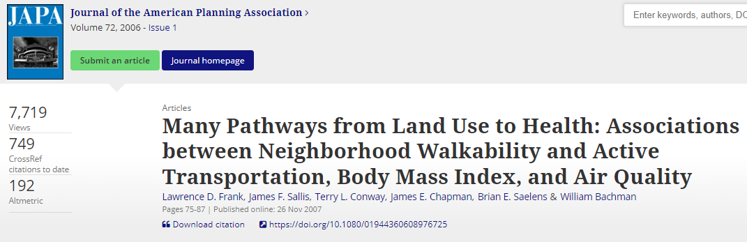

Slide 11
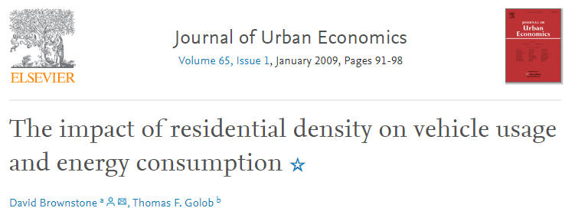

Slide 12
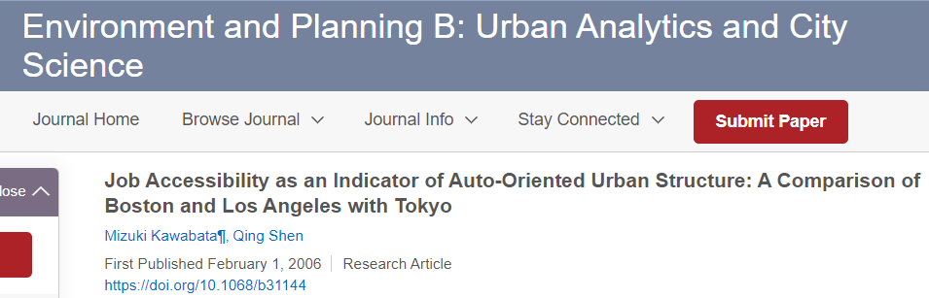

Slide 13
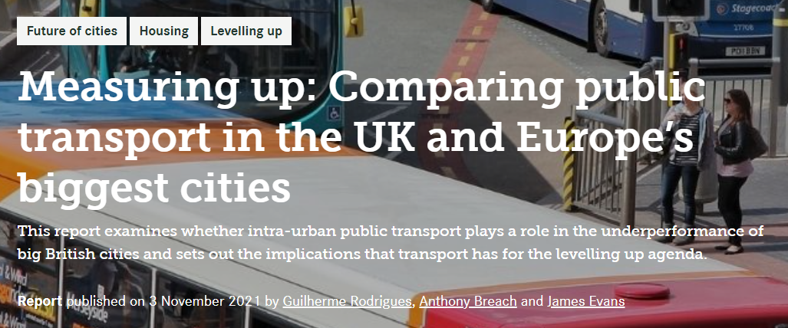

Slide 14
Research question
Multi-city comparisons
Detailed urban form characterisation
Comprehensive routing algorithm
Demographic profiling
Innovative destination selection method

Slide 15
Research question
Identify best practices and explore their potential implementation in different contexts
Multi-city comparisons
Detailed urban form characterisation
Comprehensive routing algorithm
Demographic profiling
Innovative destination selection method

Slide 16
Methods

Slide 17
Accessibility score
Morphometric analysis
Socioeconomic analysis

Slide 18
Accessibility score
Morphometric analysis
Socioeconomic analysis

Slide 19
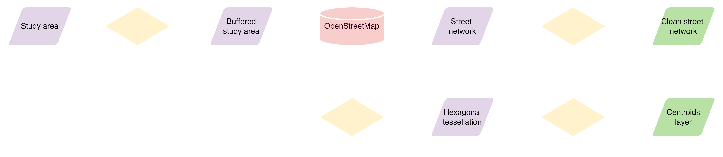
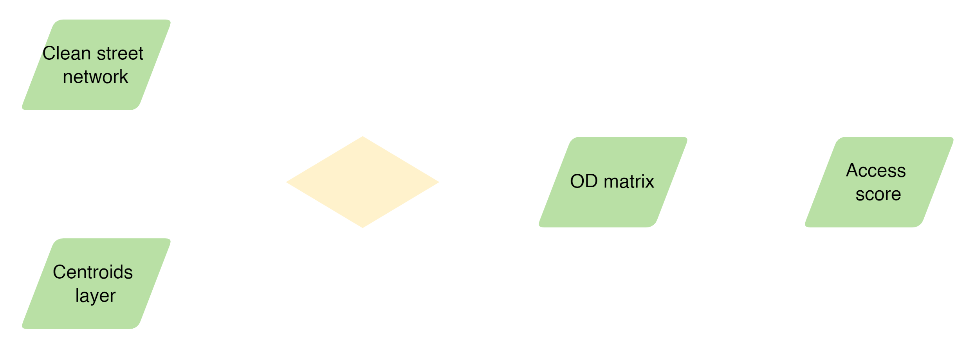
Methods – Accessibility score

Slide 20
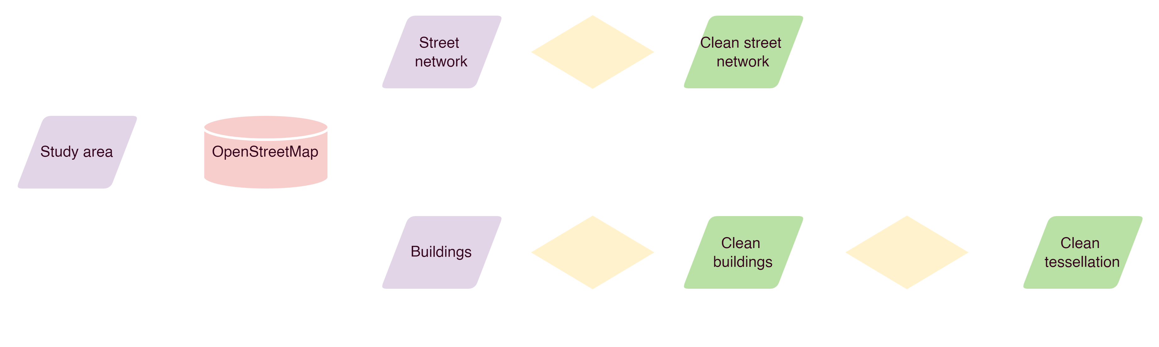
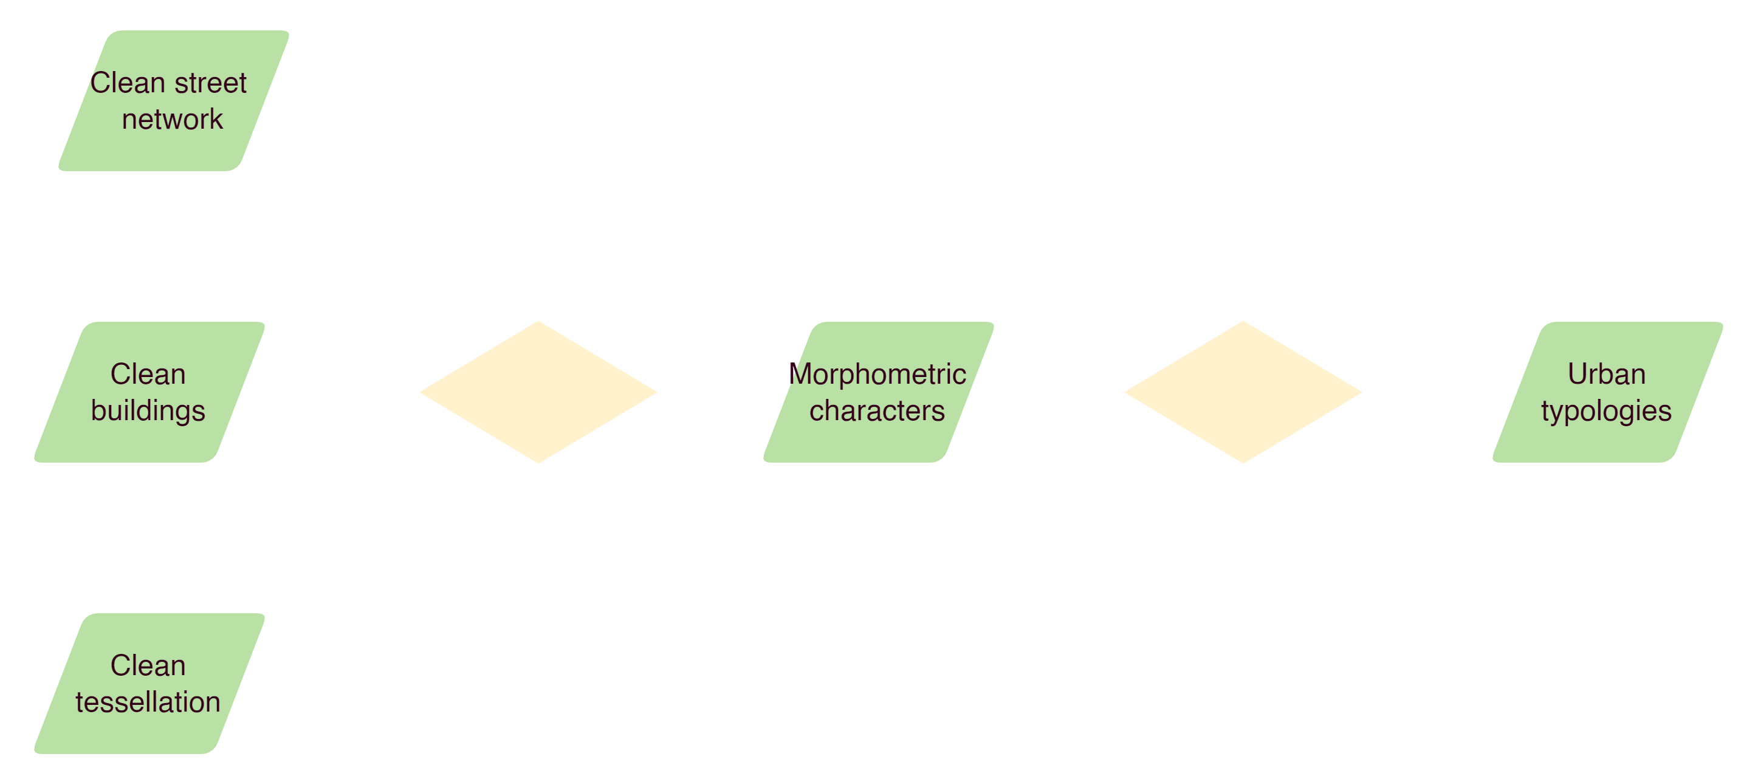
Methods – Morphometric analysis

Slide 21

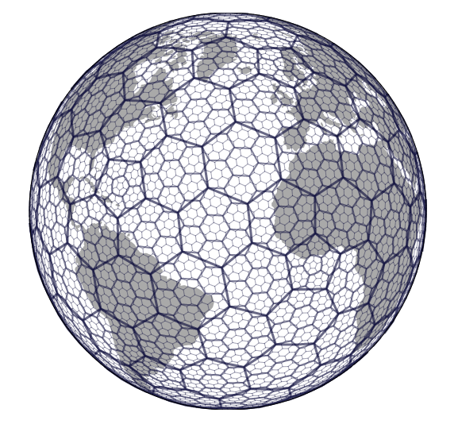


Slide 22
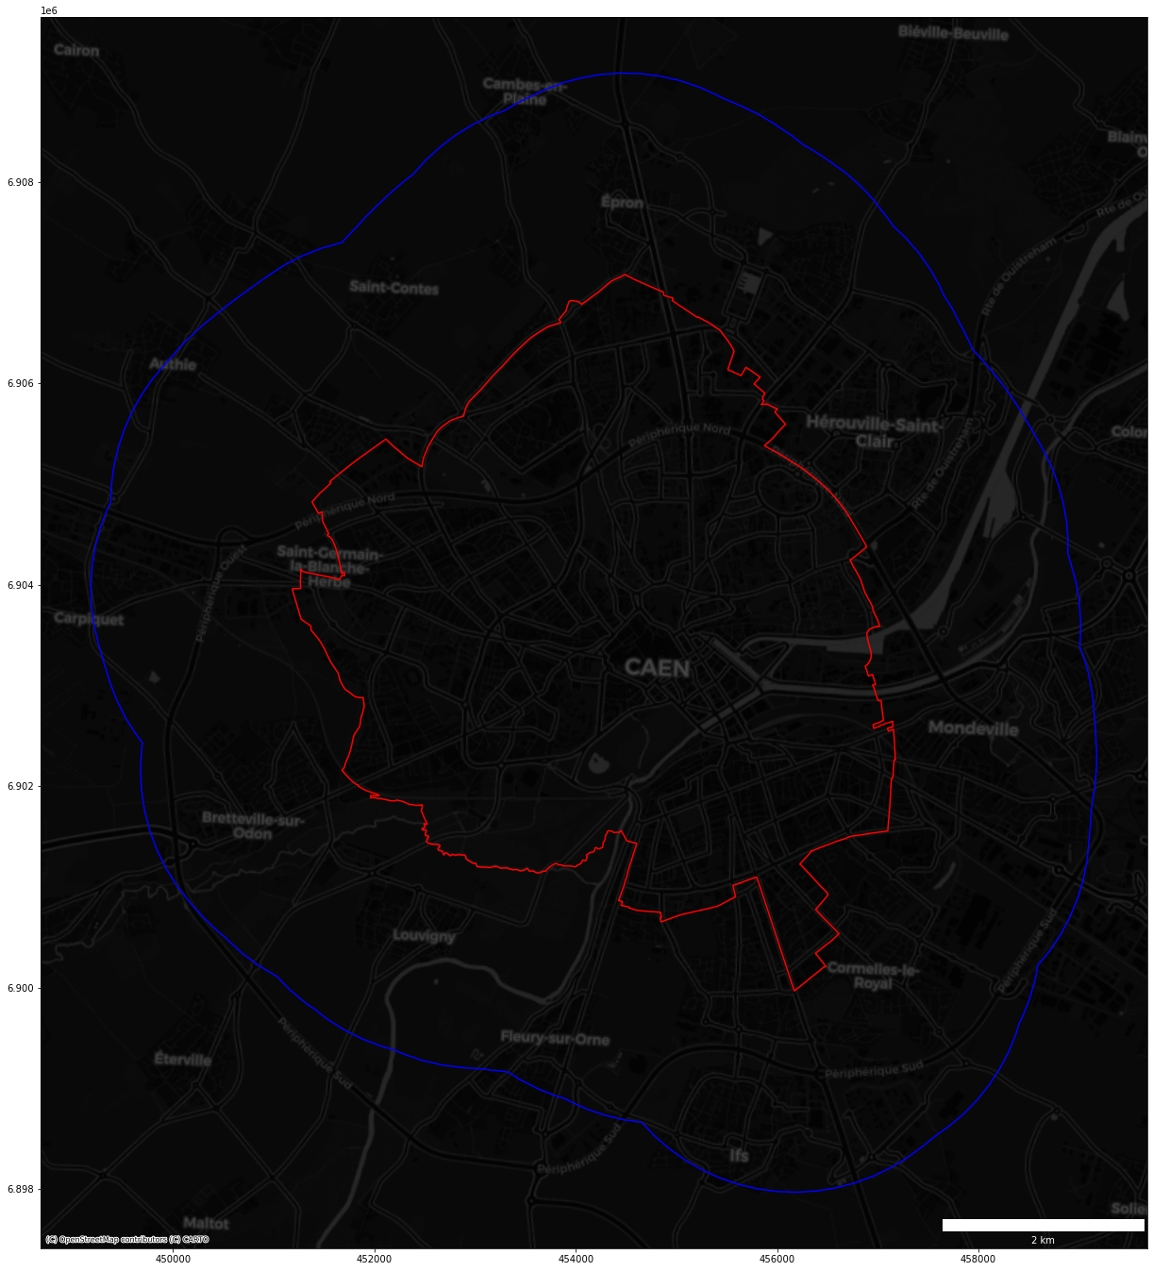

Slide 23
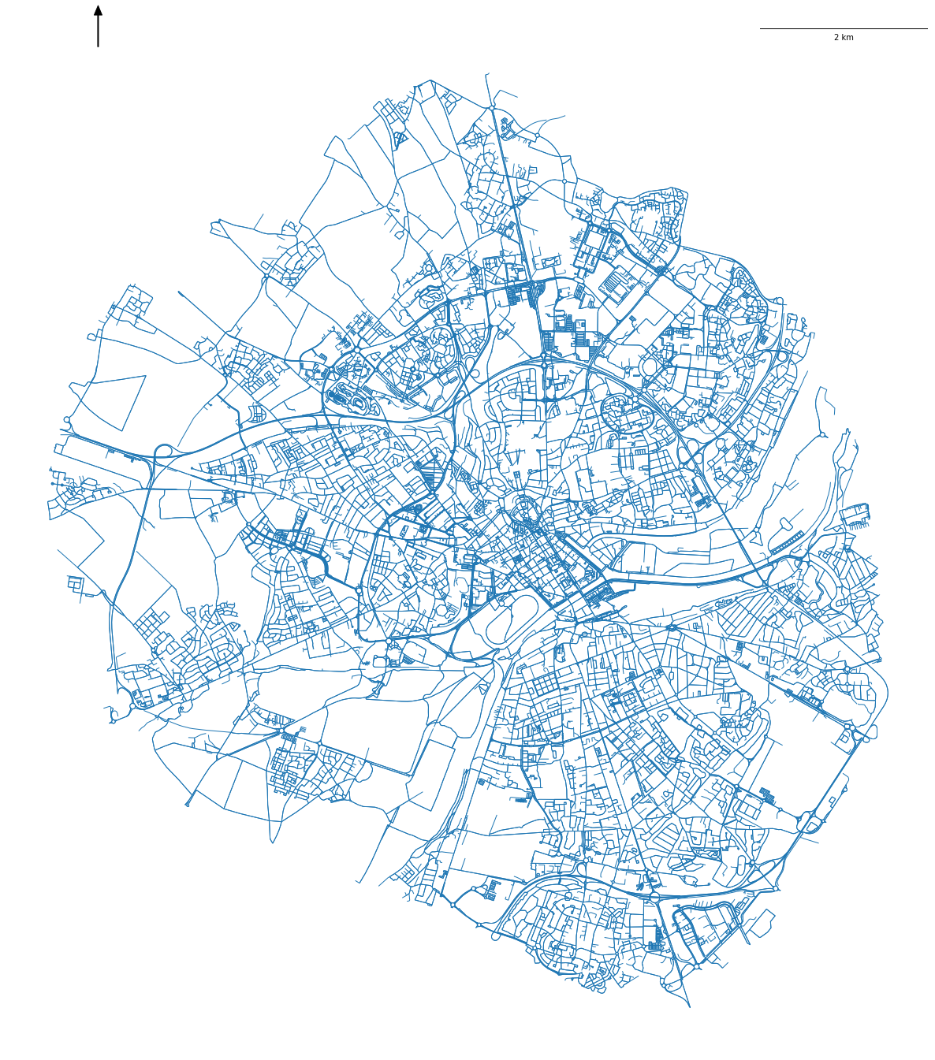
2km

Slide 24
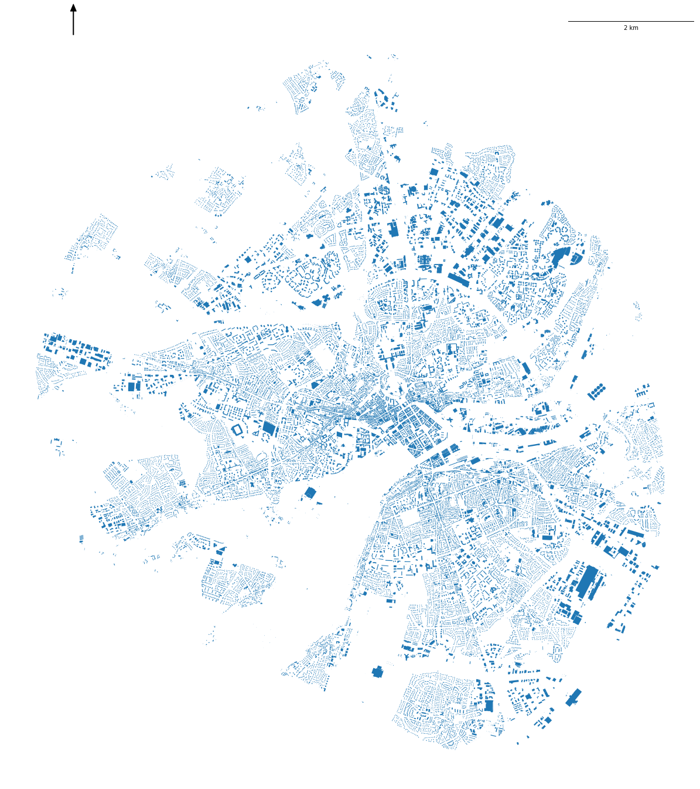
2km

Slide 25

2km

Slide 26

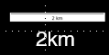

Slide 27
Results

Slide 28
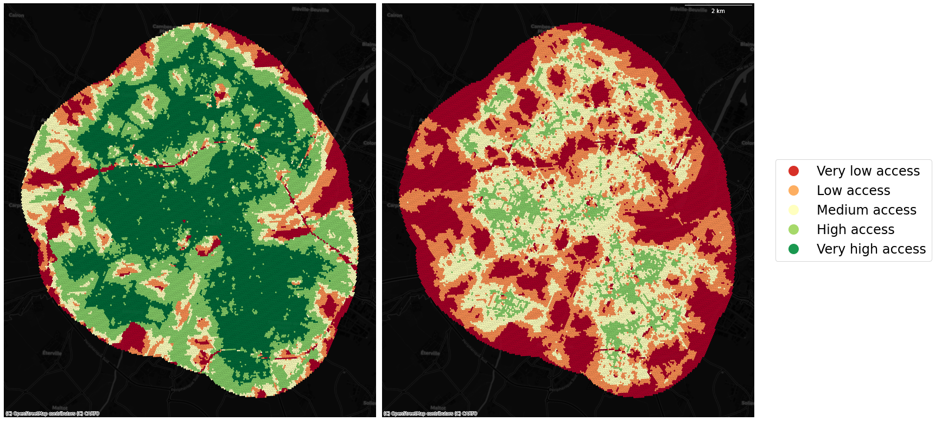
Accessibility score adults
Accessibility score seniors

Slide 29
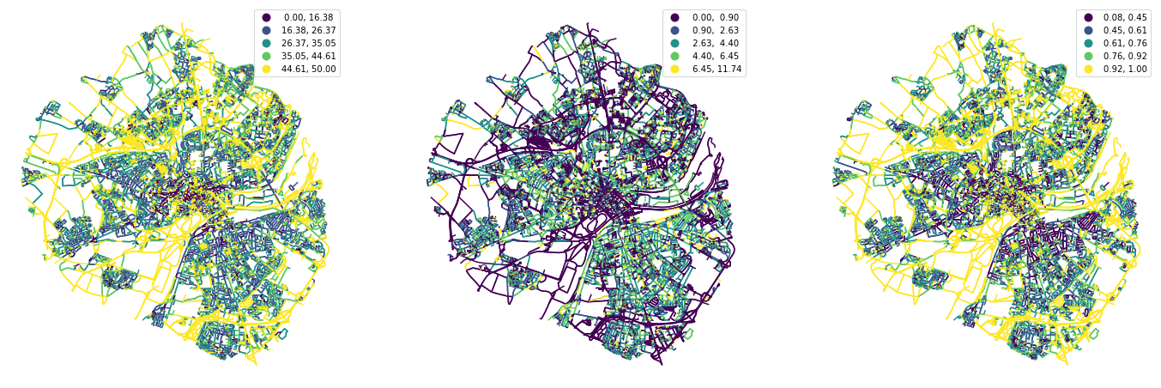
Width
Width deviation
Openness

Slide 30
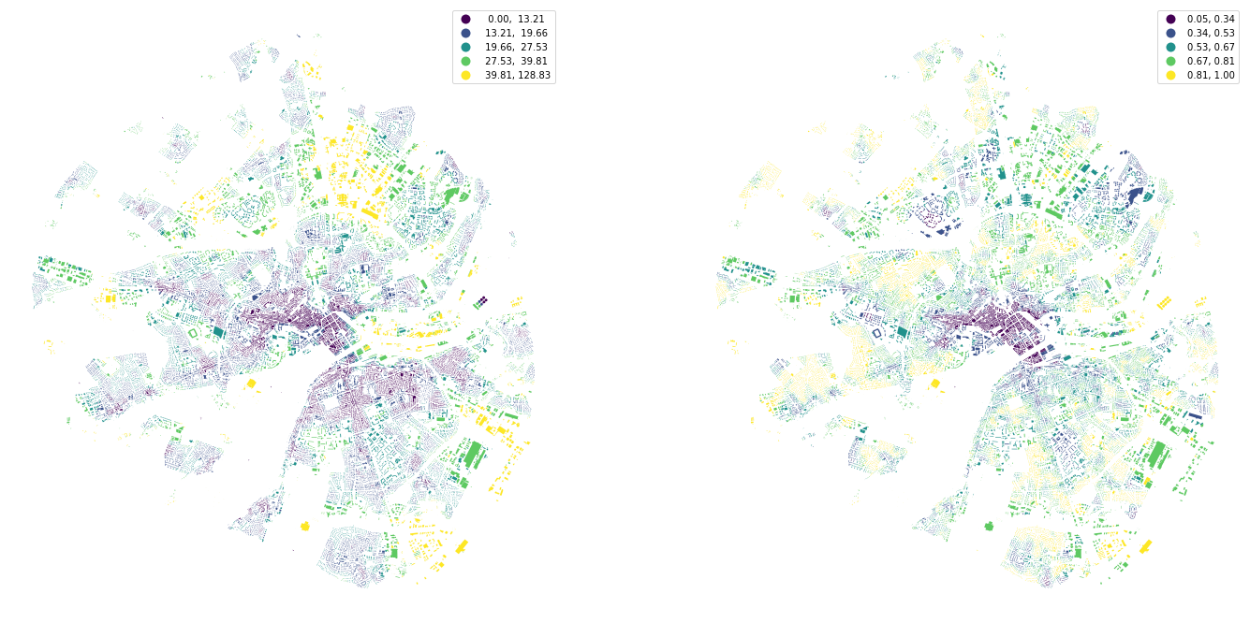
Inter-building distance
Adjacency

Slide 31
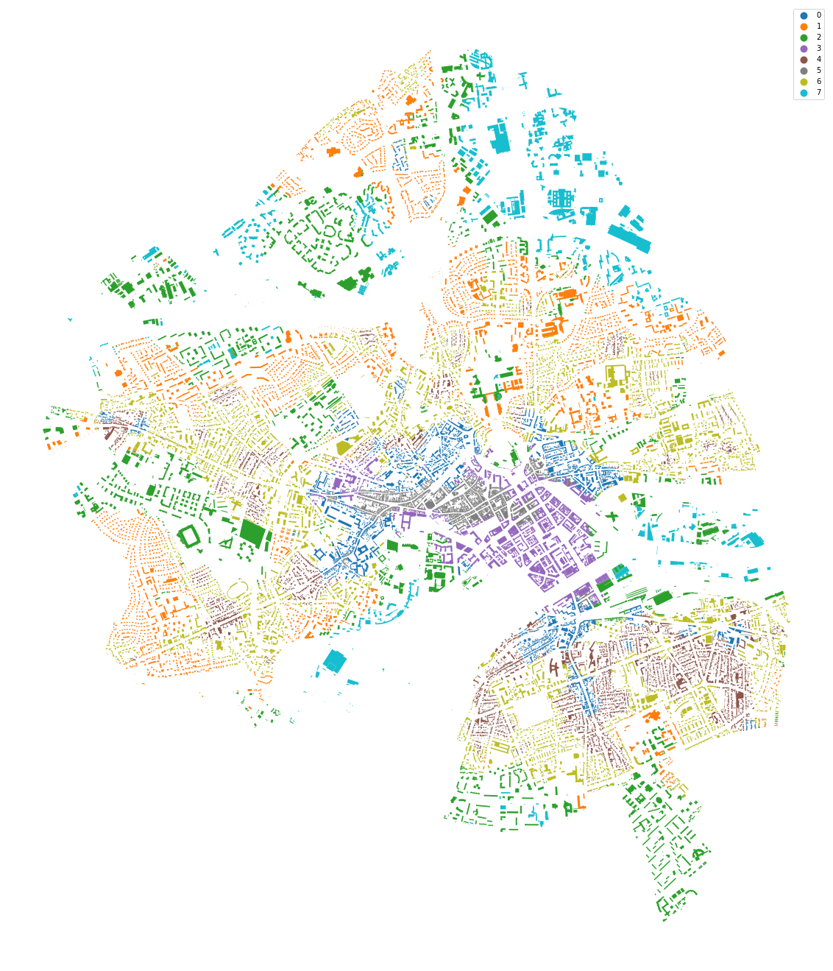
Urban typologies

Slide 32
Conclusions & future work

Slide 33
Conclusions & future work
After a very preliminary exploration, results suggest there is a relationship between accessibility and certain morphometric characters
Hexagonal tessellation can be a useful tool to standardise analyses across multiple study areas.

Slide 34
Conclusions & future work
GWR to quantify relationships between accessibility and urban form
Incorporate amenities as destinations
Assign weights to amenities based on demographic profiles
Socioeconomic & land use variables - Dasymetric population
Deep learning for urban tissue simulation

Slide 35




Thank you
c.peiret-garcia2@ncl.ac.uk
@cpeiretgarcia
cpeiret
Clara Peiret-García
CDT in Geospatial Systems
Newcastle University, UK

